Slide 1


Slide 2
Agenda
Problem Statement 03
Data Mining - 01 04
Data Mining - 02 05
Exploratory Data Analysis (EDA) 06
Data Visualization 07
Algorithms Used 08
Analysis of Results 09
Conclusion & Future Work 10

Slide 3
Problem Statement
IITS-NITS Category-wise cut off data prediction
In this dataset,the year-wise distribution of cutoffs for various IITS and NITS are collected and organized on the basis of stream,category, quota,institute _type e.t.c
There are two classes in dataset(0-1) as 0 as not preparatory and 1 as preparatory
We use classification algorithm as the target variable is discrete categorical.

Slide 4
Data Mining - 01
As mentioned below steps are the data mining steps:
1. Duplicate Values :
In these dataset the duplicate values are present
2. Null values:
There are no null values in the dataset
3. Outliers:
There are no outliers in the dataset
4. Data :
The data is Imbalance(Proportion: 27.01:1)

Slide 5
Data Mining - 02
Data type conversions:
Object types columns are converted into int type using Label Encoder
Target Variable : ”is_preparatory”
Independent Variables are :
id
Year
institute_type
round_no
Quota
Pool
institute_short
program_name
program_duration
degree_short
category
opening_rank
closing_rank

Slide 6
Exploratory Data Analysis (EDA)
Import the required libraries
Spliting the dataset into train and test
x_train
x_test
y-train
y_test
Scaling the feature by using MinMaxScaler
Build the algorithm
Build the algorithm with x_train,y_train

Slide 7
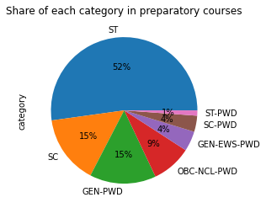
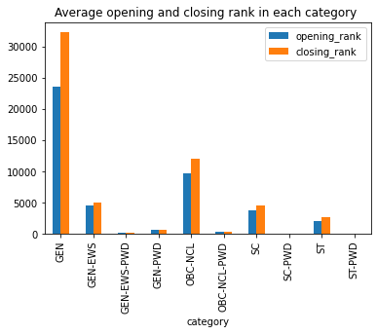
Data Visualization

Slide 8
Algorithms Used
The algorithms used for prediction are :
Logistic Regression
Decision Tree Classifier
Random Forest Classifier
Extra Tree Classifier
Navie Bayes Model
KNeighborsClassifier(KNN)
Support Vector Machines(SVM)

Slide 9
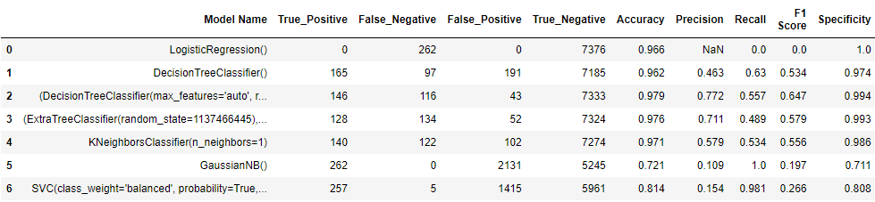
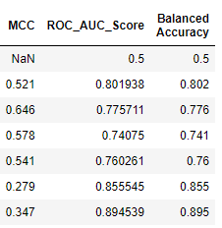
Analysis of Results

Slide 10
Conclusion and Future Work
CONCLUSION
The Project may identify the trends in category-wise cut off scores for various IITS-NITS over the years,showing whether the cutoffs have been increasing,decreasing or,remaining stable
Understanding the data is balanced or imbalanced
The highest accuracy is Random Forest Classifier
Analyzing the demographics of admitted students in different categories to ensure diversity and inclusivity in the admissions process
FUTURE WORK
Developing predictive models that can forecast category-wise cutoff scores for future admissions
Consider creating new features or transforming existing features to enhance predictive model

Slide 11
Thank You
Q & A
Student Name :E.Deepika Lakshmi
Roll Number:21B91A0452
SRKR Engineering College
Mobile: +91 9381766412
Email: 21B91A0452@srkrec.ac.in
Bhimavaram - India

